Slide 1
Introduction to ECG signal processing
Supervisor professor : Dr. Khalaj
Research supervisor : mr. fahim
Author : Mahdi siami
Summer 1401

Slide 2
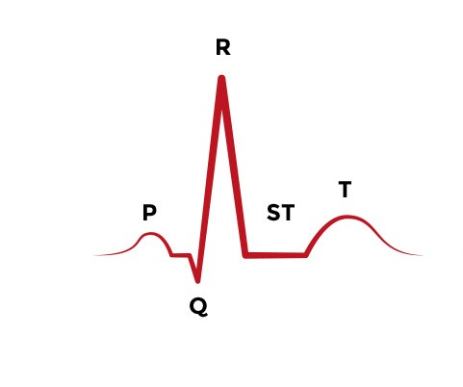
What is ecg ?
An electrocardiogram (ECG) is a simple test that can be used to check your heart's rhythm and electrical activity.

Slide 3
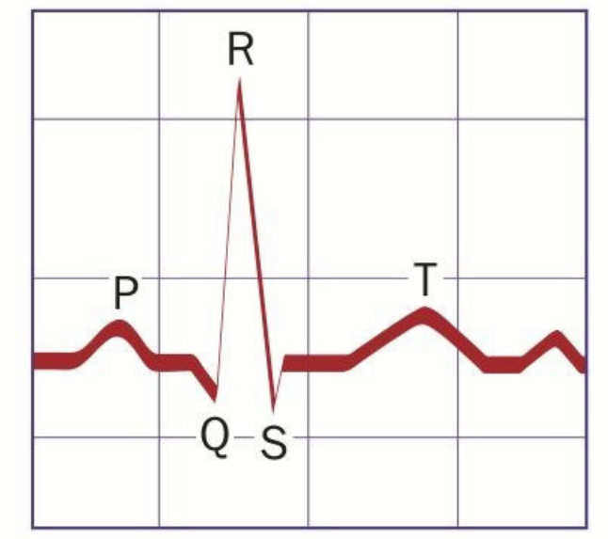
What are an Ecg morphological signal features?
P wave : The sinoatrial node (SA) is the pacemaker of the heart and produces the P wave. The P wave in an ECG complex indicates atrial depolarization.
QRS wave : The QRS wave is produced by the atrioventricular node (AV).
The QRS is responsible for ventricular depolarization
T wave : T wave is ventricular repolarization.

Slide 4
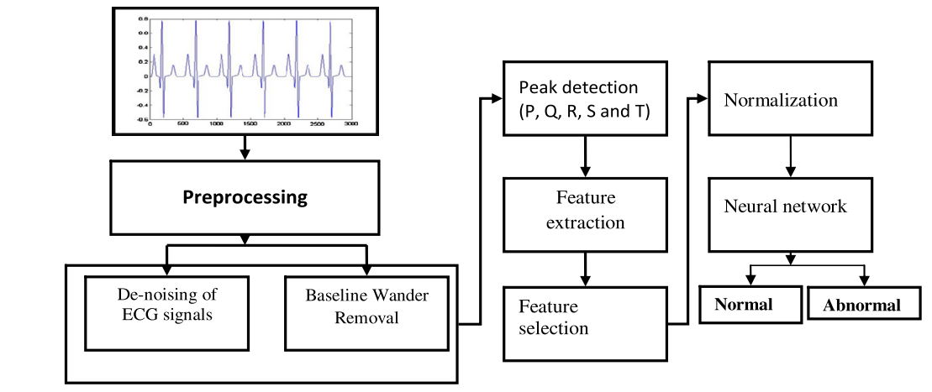
How do we process ecg signals?

Slide 5
Preprocessing 1. denoising
High frequencies
City electricity noise
…
we Usually use frequency filters for this section

Slide 6
Preprocessing 2. baseline wander removal
Base line wander :
Baseline wander is a low frequency artifact in the ECG that arises from breathing, electrically charged electrodes, or subject movement and can hinder the detection of these ST changes because of the varying electrical isoline

Slide 7
Peak detection
One common way to do this:
Initially an appropriate choice of the wavelet coefficients is done for R peak detection. After the detection of R peak, five point differentiation is done on the reconstructed wave produced by suitable selection of coefficients for Q and S points. Then the appropriate coefficients are recognized for T and P wave peak detection. Once the peak is identified, onset and offset of these waves are captured. Therefore, all five peaks (P, Q, R, S and T) are detected using discrete wavelet transform method

Slide 8
Feature detection and feature selection
We extract statistical, morphological and frequency features for our network and select proper features which gave us best results from them.
NORMALIZATION AND NETWORK
We build our network based on normalized features and classify our data.

Slide 9
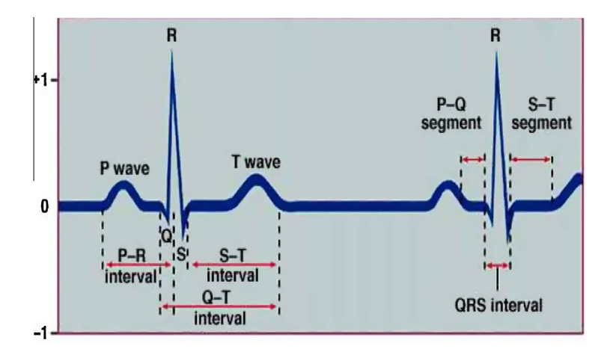
How can we use ecg?
The existing studies on ECGs have proved that the ECGs are quite unique by nature among different individuals, so we can use it to identify people.

Slide 10
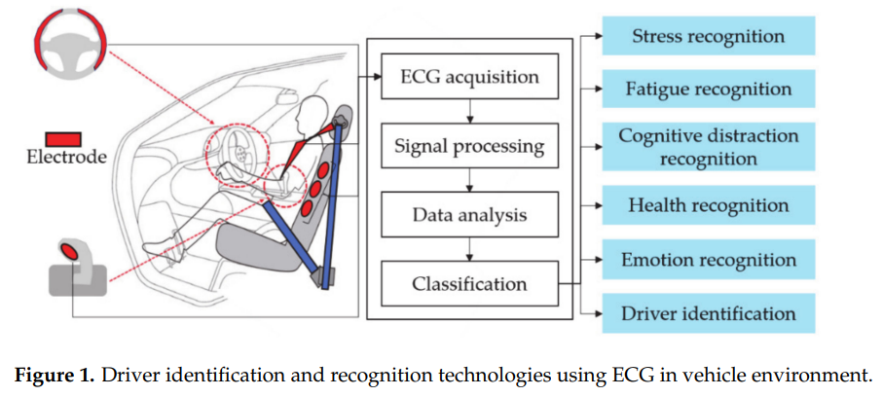
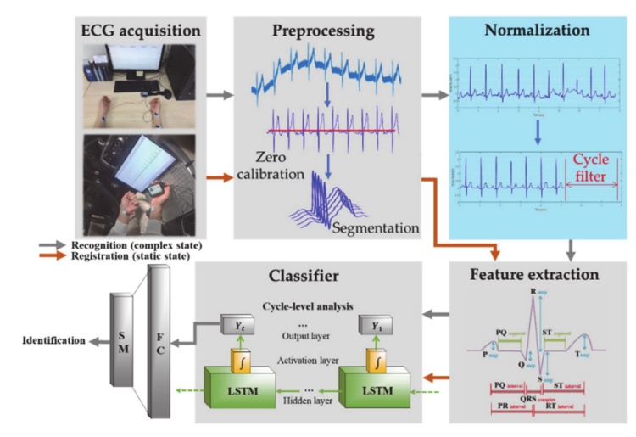
Related papers and researches
Driver Identification System Using Normalized Electrocardiogram Based on Adaptive Threshold Filter for Intelligent Vehicles [and references]

Slide 11
Thank for your attention

